Slide 1
Why Volunteer?
Why NOT Volunteer?

Slide 2
Local Opportunities
http://www.volunteertoronto.ca/
http://charityvillage.com/

Slide 3
"Networking is about doing what your mother told you to never do . . . talk to strangers. It's like playing host at someone else's party. At a real level, it's about learning about other people and finding the links that you have with them."
https://lambton.optimalresume.com/

Slide 4
The Purpose of Networking
Is NOT about connecting with the masses but it IS about building and maintaining authentic mutually beneficial relationships.

Slide 5
Networking Activity
Meet and greet
Shake hands with as many people as you can in 2 minutes, change your introduction
Pair/Share
Find 3 things you have in common that are not obvious

Slide 6
Networking Opportunities
Local events
Volunteering
Informational Interviews
Professional Associations/Groups
Networking events

Slide 7
Local Networking Groups
Young Professionals Network of Ontario
http://www.ypnontario.com/
The Hip Hause
http://thehiphaus.com/about-us/
Eventbrite – List of Networking Events in TO
https://www.eventbrite.ca/d/canada--toronto/networking/
10 Thousand Coffees
https://www.tenthousandcoffees.com/
https://twitter.com/10kcoffees?lang=en
Meetup.com – Lots of Networking Events!
https://www.meetup.com/topics/professional-networking/

Slide 8
Informational Interviews
An informational interview is an interview conducted to collect information about a job, career field, industry or company.
http://www.quintcareers.com/informational_interviewing.html

Slide 9
Networking Online
Discussion boards
Online Networking
LinkedIn
Twitter
Facebook
Professional Associations Sites
Blogs

Slide 10
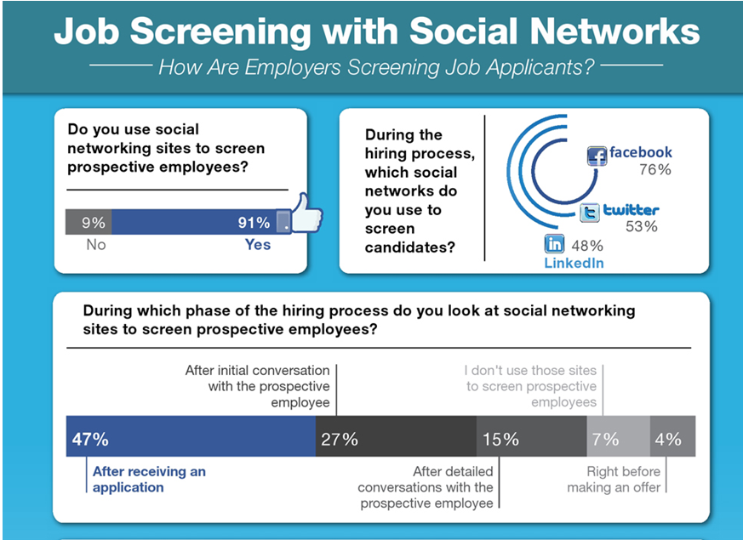

Slide 11
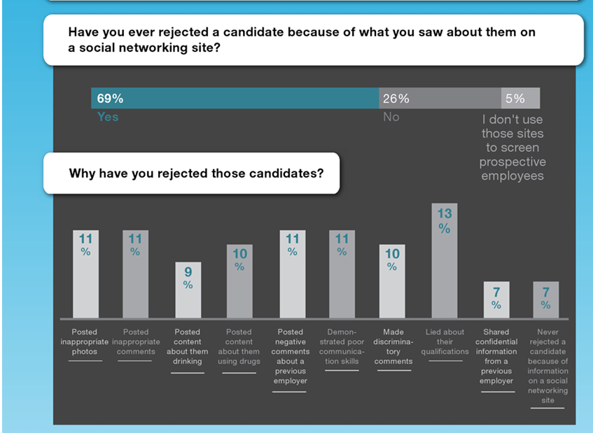

Slide 12
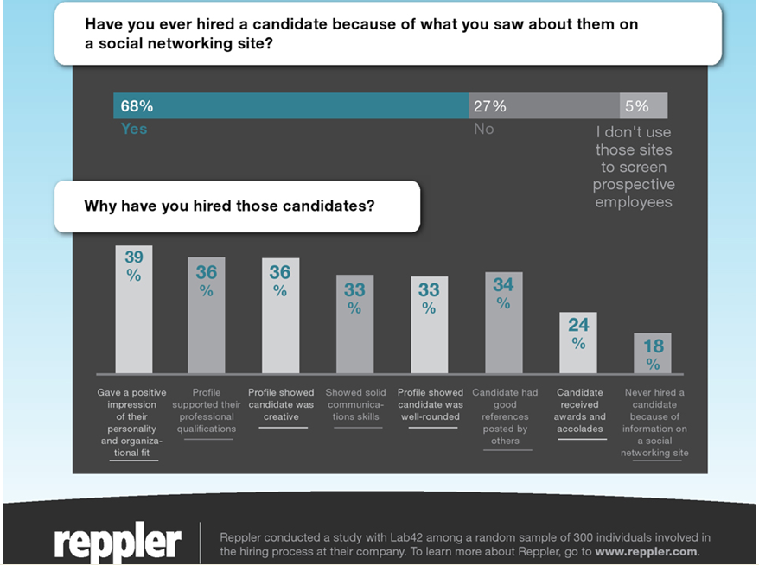

Slide 13
Google
Yourself

Slide 14
Employers don’t usually search with the hopes of finding something negative about you. The opposite is true- they’re looking to confirm the information on your resume and hoping to find more proof that you’re a good candidate who really can help their company. However, employers can’t predict how their search will end, only you can control this.

Slide 15
PROFESSIONAL
Online Presence
Vs
SOCIAL
Online Presence

Slide 16
Social Media Sites
https://identity.utexas.edu/everyone/how-to-manage-your-social-media-privacy-settings

Slide 17
Linkedin
The worlds largest professional network
400 million people
https://www.linkedin.com/static?key=what_is_linkedin

Slide 18
Week #7 – Online Work
Professional Online Presence
Read - http://www.eofire.com/7-ways-to-build-your-online-presence/
Build Your Platform
Review the following resources
https://university.linkedin.com/content/dam/university/global/en_US/site/pdf/LinkedIn%20Profile%20Checklist%20-%20College%20Students.pdf
https://university.linkedin.com/content/dam/university/global/en_US/site/pdf/TipSheet_BuildingaGreatProfile.pdf
Create a complete Linkedin Profile
Why do this?
Read - http://theundercoverrecruiter.com/7-ways-college-students-can-benefit-linkedin/

